Slide 1
Radiogenomic Analysis of Glioblastoma with Deep Learning Techniques
01/17/2021
Yichong Wang
wangyichong@u.nus.edu

Slide 2
Brief Introduction

Slide 3
Glioblastoma
Glioblastoma (GBM) is a highly aggressive adult brain tumor and the deadliest brain tumor that originates in glial cells.
A high degree of heterogeneity in both space and time
Do not respond well to prescribed therapy because therapy targets the entire tumor rather than specific genetic sub-regions.
Three main criteria to divide GBM subtypes
The most common subtype we use in lab is Varhaak et al. research in 2010

Slide 4
Radiogenomics
Image acquisition;
Image processing, including noise/artifact reduction, intensity and/or orientation standardization, coregistration of the multiparametric MRI scans
ROI definition using manual annotation or automatic segmentation
Feature extraction based on human-engineered (conventional radiomics) or deep-learning approaches
Data analysis, involving machine/deep-learning methods for feature selection, classification, and cross-validation

Slide 5
Progress made to-date

Slide 6
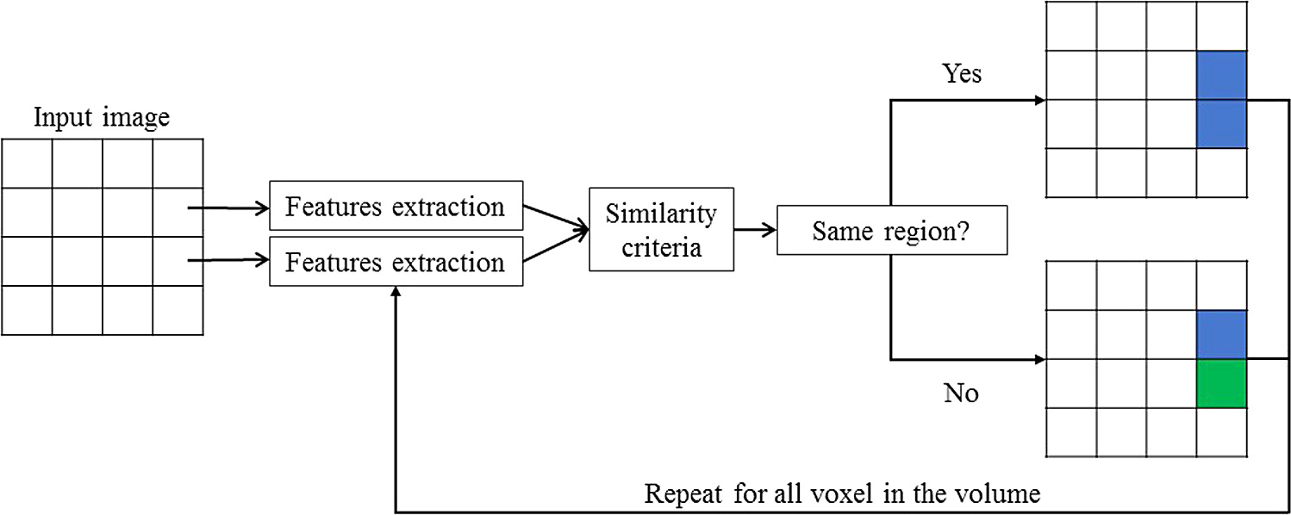
Segmentation Result
Region-based Approaches
Classification approaches
Edge-Based Approaches
Altas-based approcahes

Slide 7

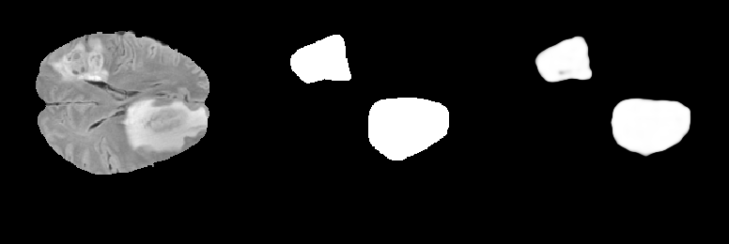
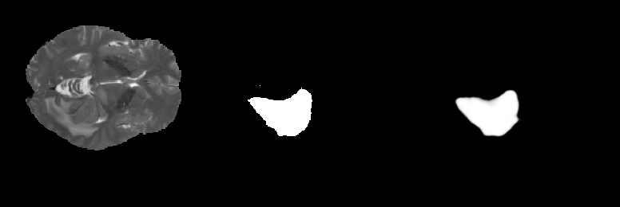
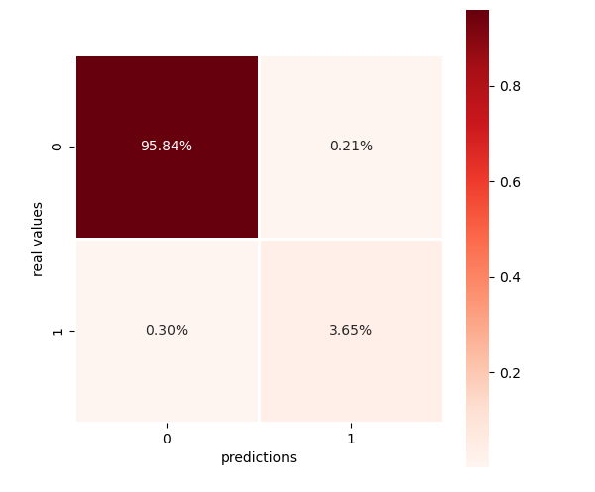
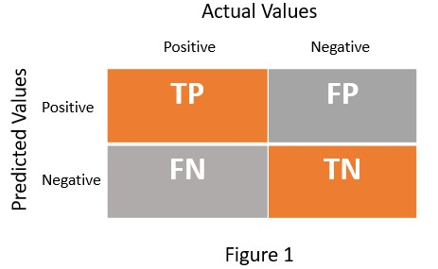
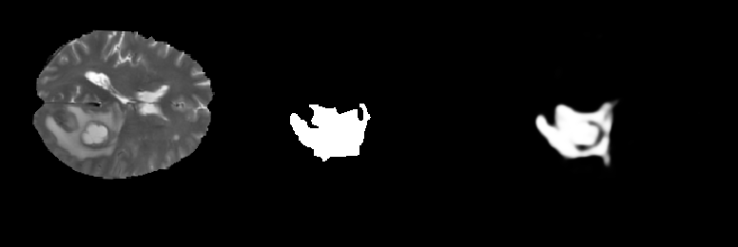
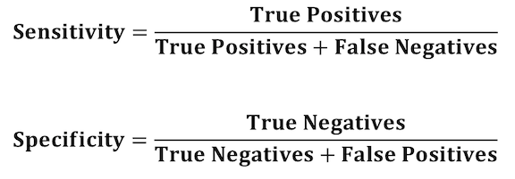
Segmentation Result
Dataset: 39 Patients
MRI Series: T1,T2,FLAIR
Plane: AX, COR, SAG
Totally 18528 Images
Train : Test = 4 : 1
Train times: 225248
U-net
Sensitivity and Specificity:
Sensitivity>95%
Confusion Matrix of all image segmentation results
Left: MRI Image, Middle: Ground Truth, Right: Semgentation Results

Slide 8
Feature Extraction
In the feature Extraction procedure, we apply conventional CV method, using specific equation to calculate features to put image information from 2D to 1D
At first, I use my own code to calculate features, but the speed is slow. Right now, we use pyradiomics module to extract features from ROI
Pyradiomics have 120 features, most of them are texture features.
The most classical texture feature design is using GLCM

Slide 9
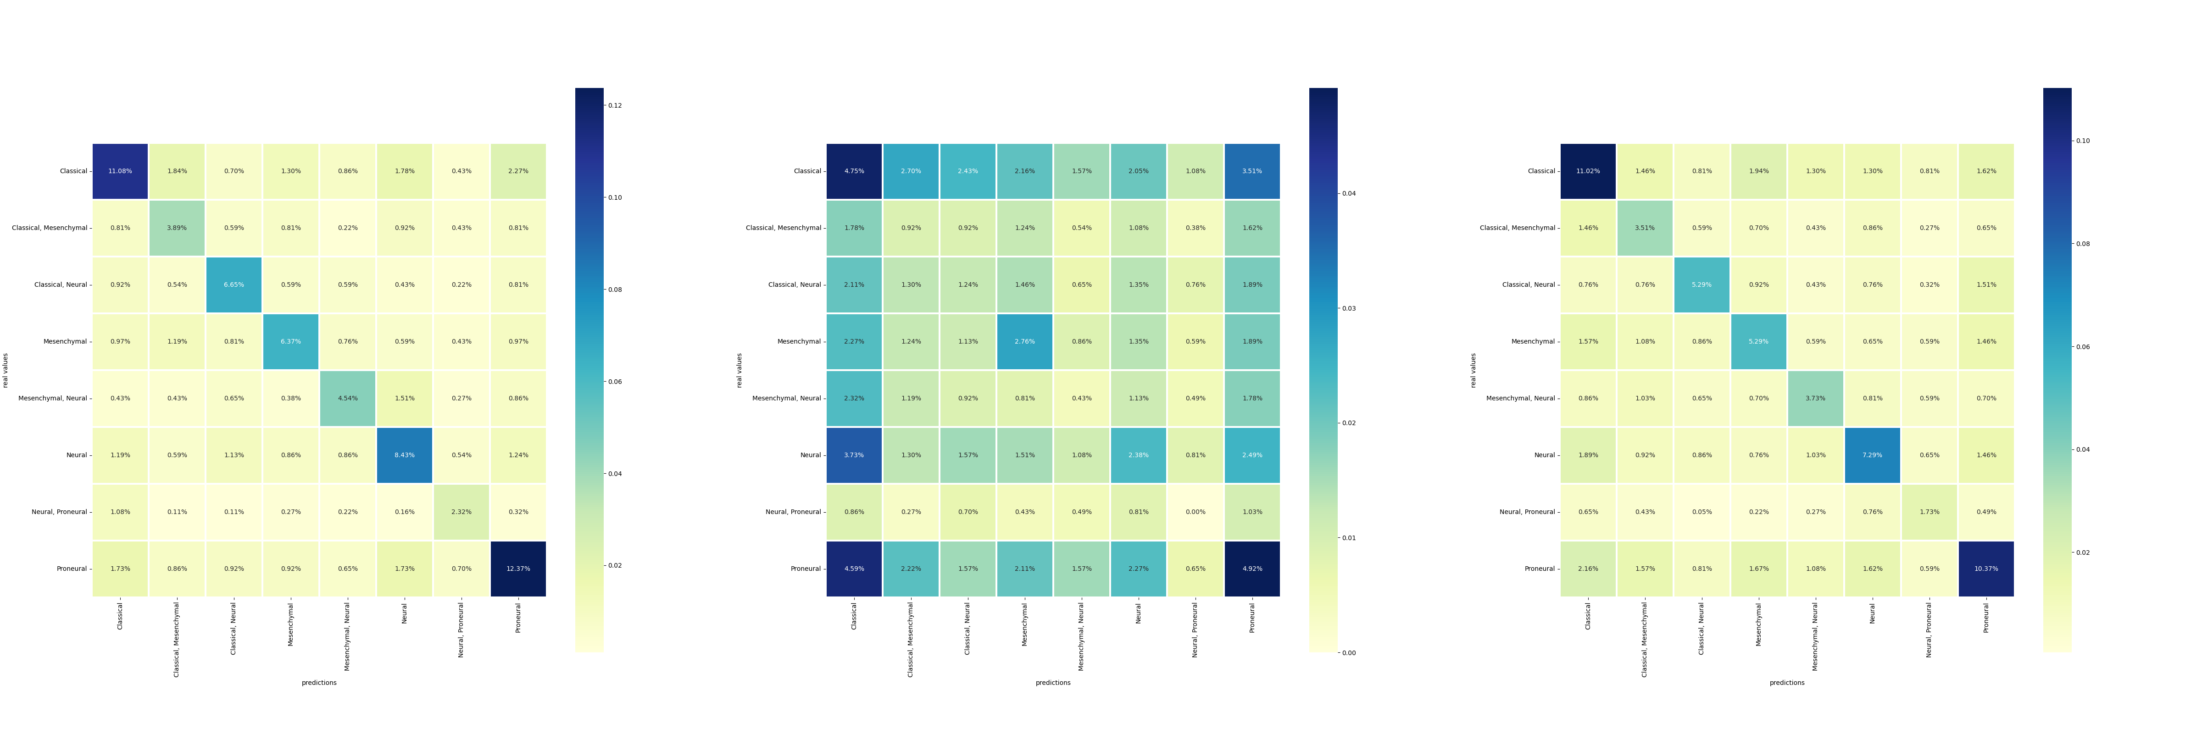
Classify GBM Subtypes
Decision Tree:
Original Data
PCA Data (99% information)
PCA Normalized Data
Need Normalize before PCA

Slide 10
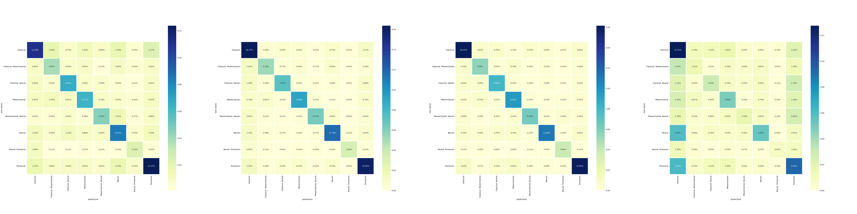
Classify GBM Subtypes
Overview:
Decision Tree: 56%
Random Forest: 77%
MLP: 80%
Linear SVM: 40%
MLP have the best preference in classifying this dataset
This dataset is not linear relationship

Slide 11
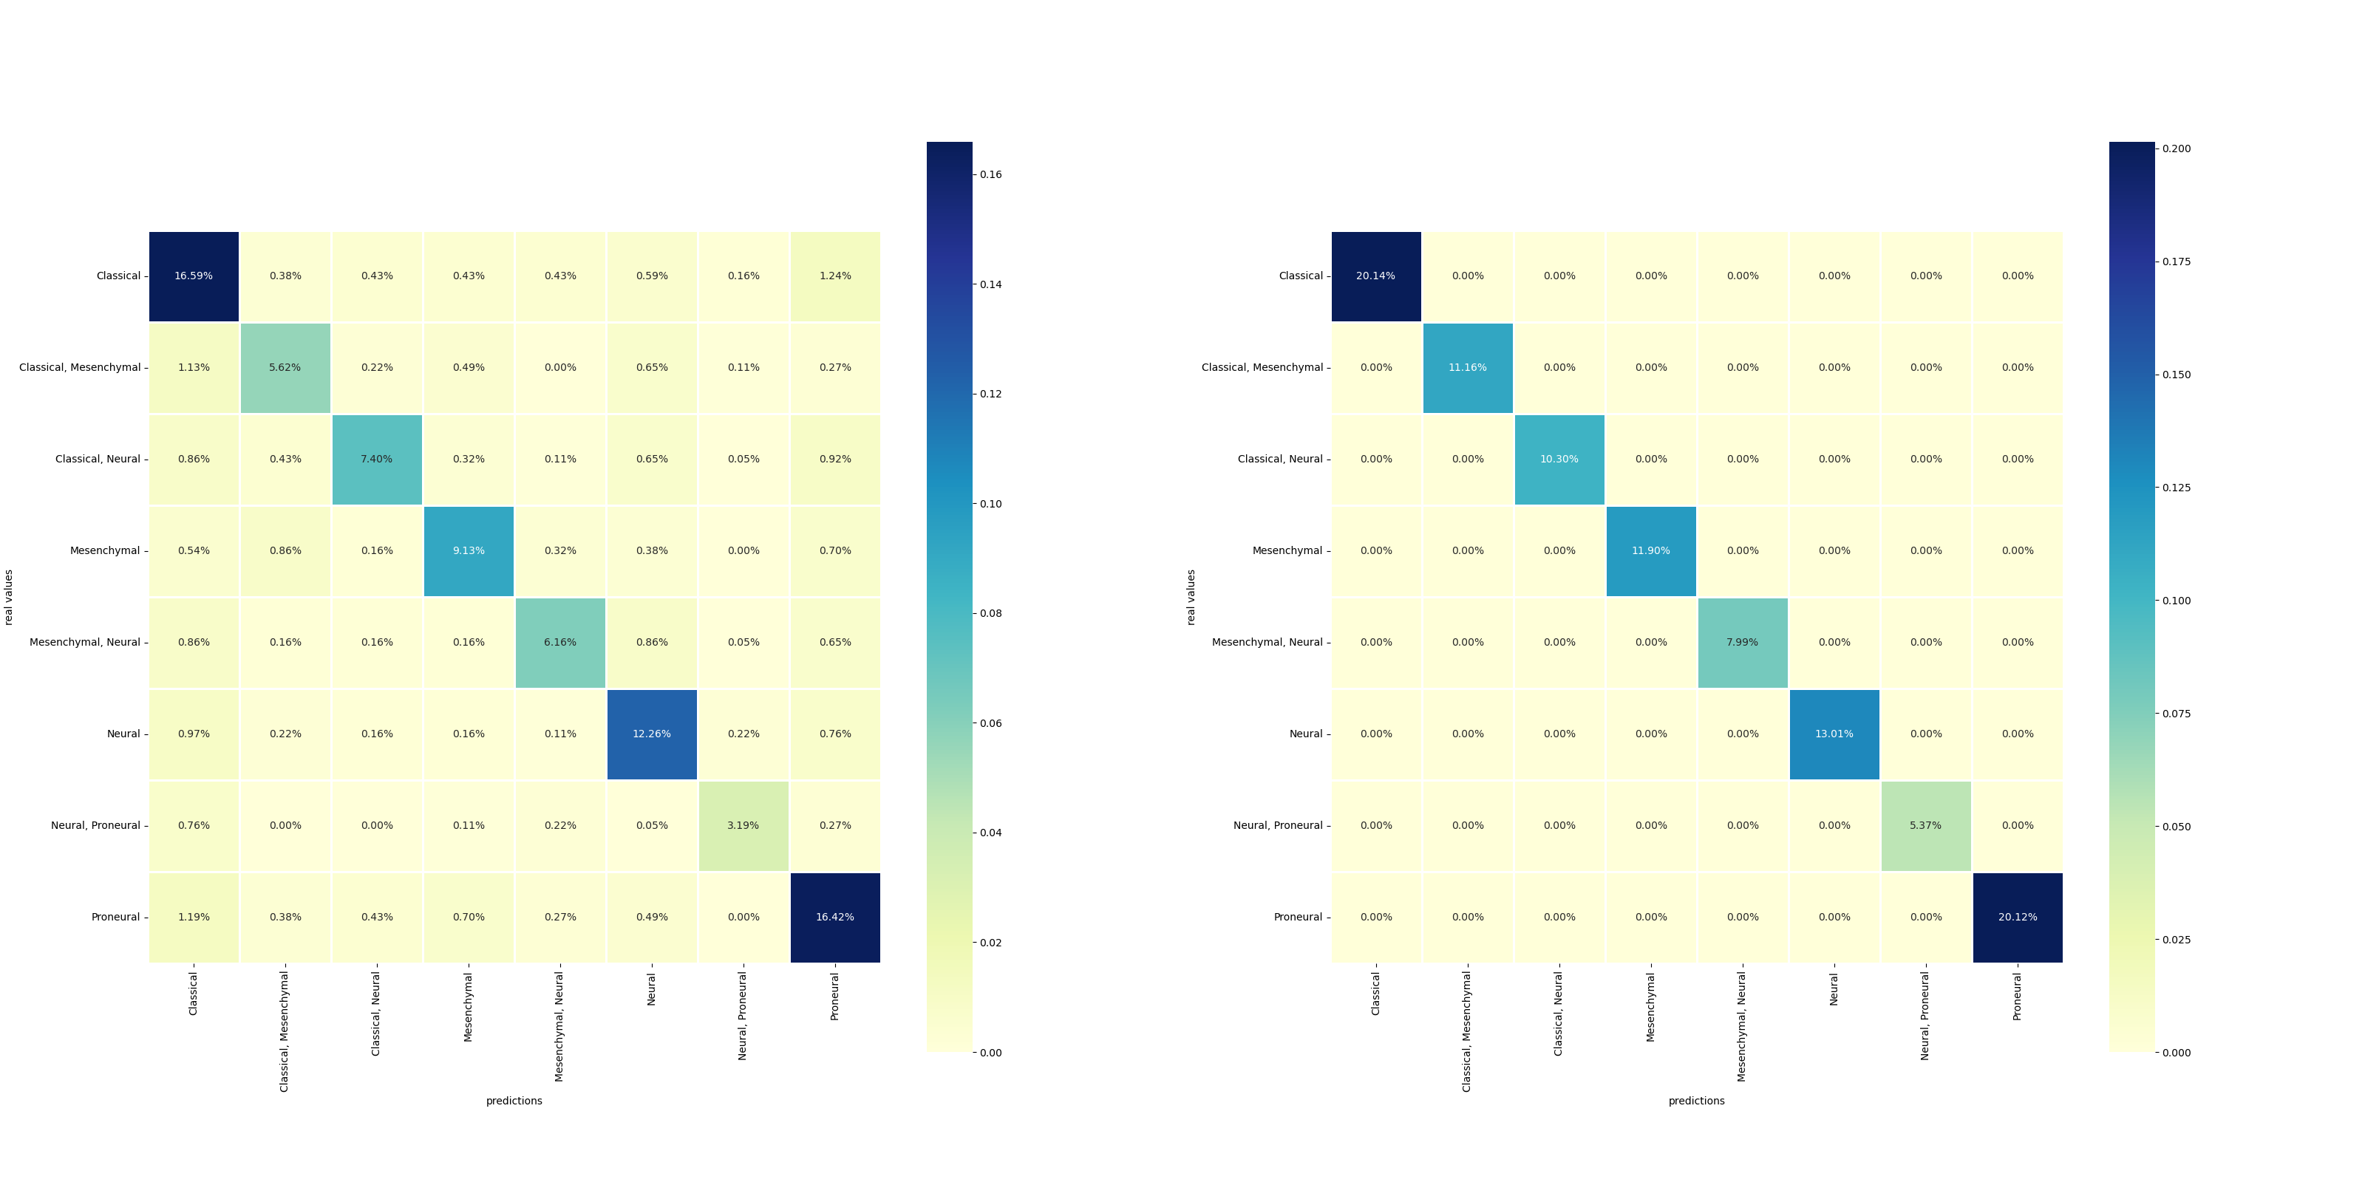
Classify GBM Subtypes Problems
Overfit:
Even add random forest tree numbers into 500, the overfit question still exist (Train accuracy = 100%)
This problem exist in every algorithms I have ever tried

Slide 12
Classify GBM Subtypes Problems
Imbalance:
Data Imbalance, the Classical and Proneural is the most subtypes of GBM, leading to data imbalance,
which may lead classical and proneural type prediction sensitivity is higher, but others will be lower

Slide 13
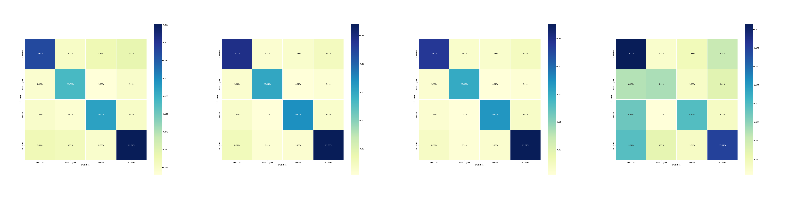
Classify GBM Subtypes Problems
Decision Tree: 68%
Random Forest: 84%
MLP: 88%
Linear SVM: 54%
Because one GBM cancer in one patient have different subtypes in different subregions, using two subtypes combined into a tuple as a label is very not scientific

Slide 14
Future Plan

Slide 15
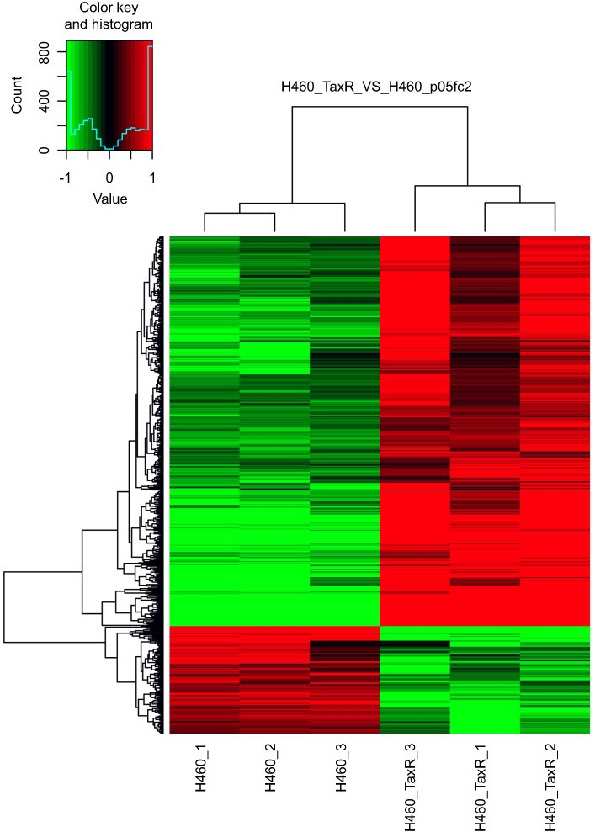
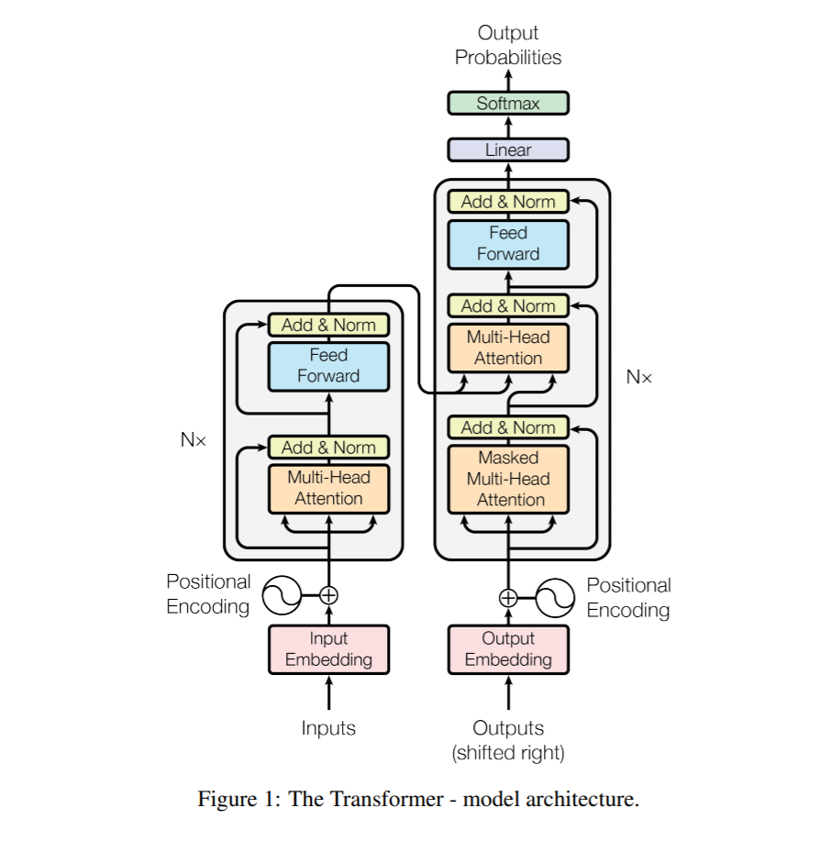

Improvements and Other direction
Using Transformer Network replace U-net (CNN) and Pyradiomics to do feature extraction to do classification
Using gene data to map radiomic features with gene data.
Predict key gene mutation or not.
Learn Qt to make UI

